Slide 1

Optimizing Supply Chain Using Shipment Pricing Data
Analysis of USAID SCMS delivery data to identify cost drivers and optimize logistics efficiency.

Slide 2





Project Overview
Goal
Dataset
Analyze shipment pricing to identify cost drivers
USAID SCMS Delivery History (10,324 records)
Tools
Focus
Python, Tableau, Plotly
Pricing trends, manufacturing sites, shipment modes

Slide 3






Research Questions
Predictive Analytics
How can we improve forecasting?
Cost Drivers
What factors impact shipment pricing?
Strategy Optimization
Which supplier and shipment approaches reduce expenses?

Slide 4
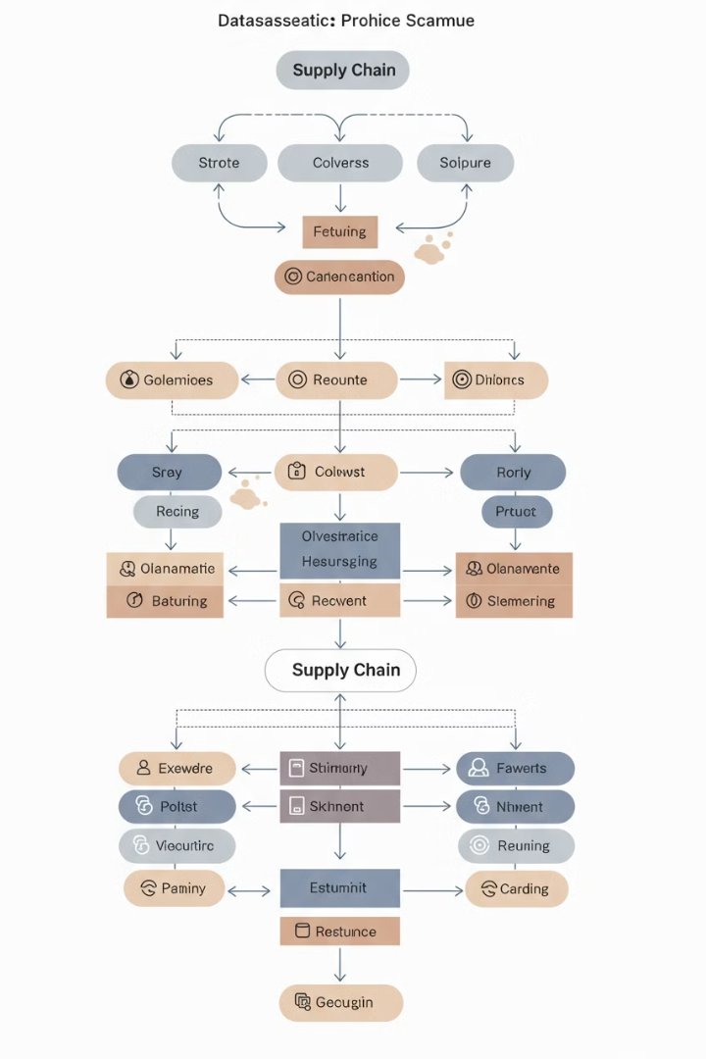
Dataset Description
File
SCMS_Delivery_History_Dataset.csv
Fields
Country, Shipment Mode, Pack Price, Manufacturing Site
Records
10,324
Coverage
Global shipments including Nigeria, South Africa, Côte d'Ivoire

Slide 5
Top Country Insights
Top Countries by Shipment Count
Top Countries by Pack Price
South Africa: 1,406 shipments
Nigeria: $25,620.72
Nigeria: 1,194 shipments
South Africa: $24,318.90
Côte d'Ivoire: 1,083 shipments
Côte d'Ivoire: $22,882.35

Slide 6

First Line Designation & Shipment Mode
Air
Sea
Courier
Truck
Other
Air shipment mode dominates despite higher costs. High variance among first line designation categories.

Slide 7

Manufacturing Site Analysis
Aurobindo Unit III, India
Mylan Nashik
3,172 total shipments
1,415 total shipments
1,694 air shipments
Hetero Unit III Hyderabad
869 total shipments

Slide 8

Shipment Mode & Pack Price
82.35
27%
$$$
Units per Air Shipment
Air Shipment Usage
Air Cost Rank
Average quantity
Despite highest cost
Highest among modes
Sea mode demonstrates better cost efficiency despite lower usage rate.

Slide 9





Cost Optimization Opportunities
Mode Switching
Air to sea conversion for non-urgent shipments
Volume Bundling
Consolidate smaller shipments
Supplier Clustering
Group by cost and volume
Scenario Analysis

Slide 10

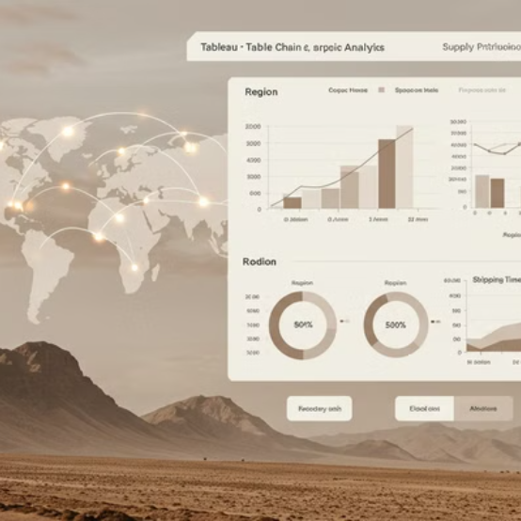

Visualization Tools
Python libraries power analysis while Tableau enables interactive dashboards. Future: real-time tracking integration.

Slide 11








Key Takeaways
Geography Impact
Air Optimization
Country selection significantly affects costs
Bundle volume for cost efficiency
Predictive Planning
Manufacturing Sites
Analytics guide smarter shipments
Key sites dominate high-cost lanes

Slide 12

Conclusion & Next Steps
Time-Series Forecasting
Implement ARIMA/Prophet for price trends
Supplier Clustering
Develop negotiation

